Slide 1

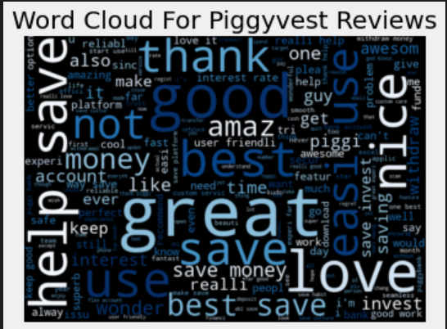
Group Presentation On An Intelligent Decision Support System On Sentiment Analysis Using Machine Learning Model
Group Members
Kingsley Ihemere Mary Emanyo Caroline Ighodalo Samuel Ekwealor Ugochukwu Onuora Pascal Ojukwu

Slide 2
Table of Content
Introduction
Problem Statement
Algorithm and Dependencies
System Design and Architecture
Results & Recommendation

Slide 3
Introduction
The Nigerian FinTech market is currently booming, and the competition is very high. As a result, a huge amount of unstructured data is generated daily.
Being able to quickly analyze reviews and resolve customers’ dissatisfaction will make a company one step ahead of her competitors.
Sentiment analysis or opinion mining is the industry standard to quickly understand customers feelings.
It uses a series of natural language processing libraries and toolkit to easily predict a person’s feelings.

Slide 4
Problem Statement
The stakeholders of Piggyvest wants to ensure high customer retention amidst the competition in the FinTech market.
They decided to follow up on every dissatisfied client so as to understand what part of their services they are not satisfied with.
They agreed to build a sentiment analysis machine learning based intelligent decision support system that will: Take new reviews, clean, prep and predict sentiment from the reviews on the ML model. Any sentiment predicted to be negative should automatically be sent to the emails of the stakeholder for immediate follow-up.

Slide 5
Algorithms & Dependencies
Google Play Scraper
Data Ingestion
Pandas
Regular Expression
Matplotlib
Numpy
Regular Expression
Data Manipulation, cleaning and visualization
Naïve Bayes Classifier
Support Vector Classifier
CountVectorizer
GridSearch
Algorithms
TextBlob
WordCloud
Porter Stemmer
Stopword
nltk
Sentiment, Polarity and Natural Language Toolkit
OS
SMTPLib
SSL
EmailMessage
Email Automation

Slide 6







System Design and Architecture
Prediction
Email Automation
new_piggyvest.csv
Polarity
Preprocessing
Predict
cleaning
Subjectivity
Staging Area
Bag of word .pkl
Save Model
Google Play Scraper
stemming
WordCloud
Train Model
piggyvest.csv
Preprocessing
Data Ingestion
Exploratory Data Analysis
Model Building

Slide 7
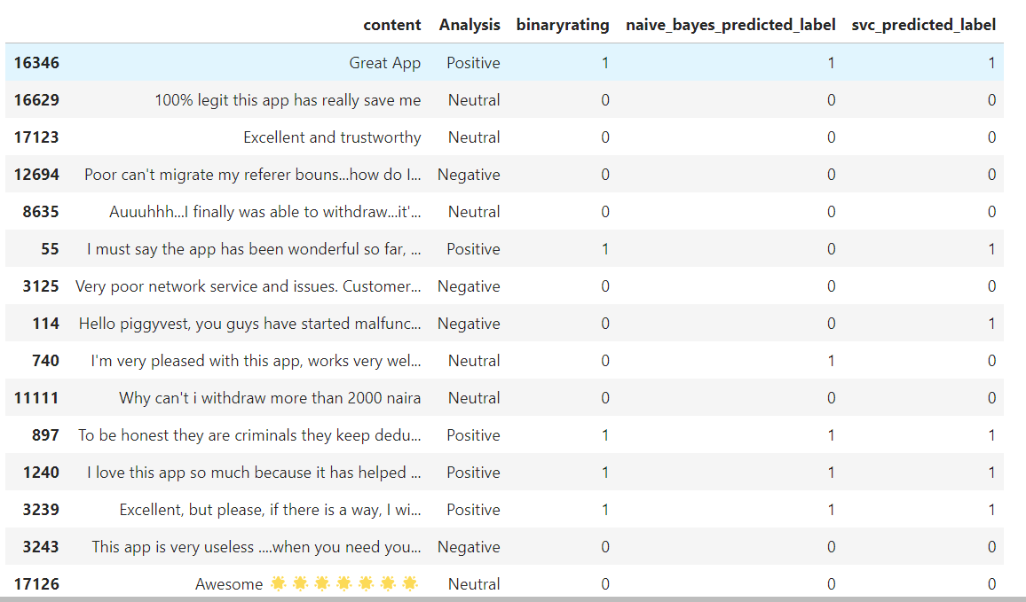
The algorithms used were naïve bayes and support vector classifier. However, SVC predicted better than naïve bayes. The image, shows the result of our prediction column 4 is for Naïve Bayes Classifier while column 5 is for Support Vector Classifier.
The system automatically emails the negative sentiments to the stakeholders for decision making.
Because the accuracies are not 100%, it is recommended that the stakeholders verify any conflicting result from both algorithms against the reviews.
Result & Recommendation

